Slide 1
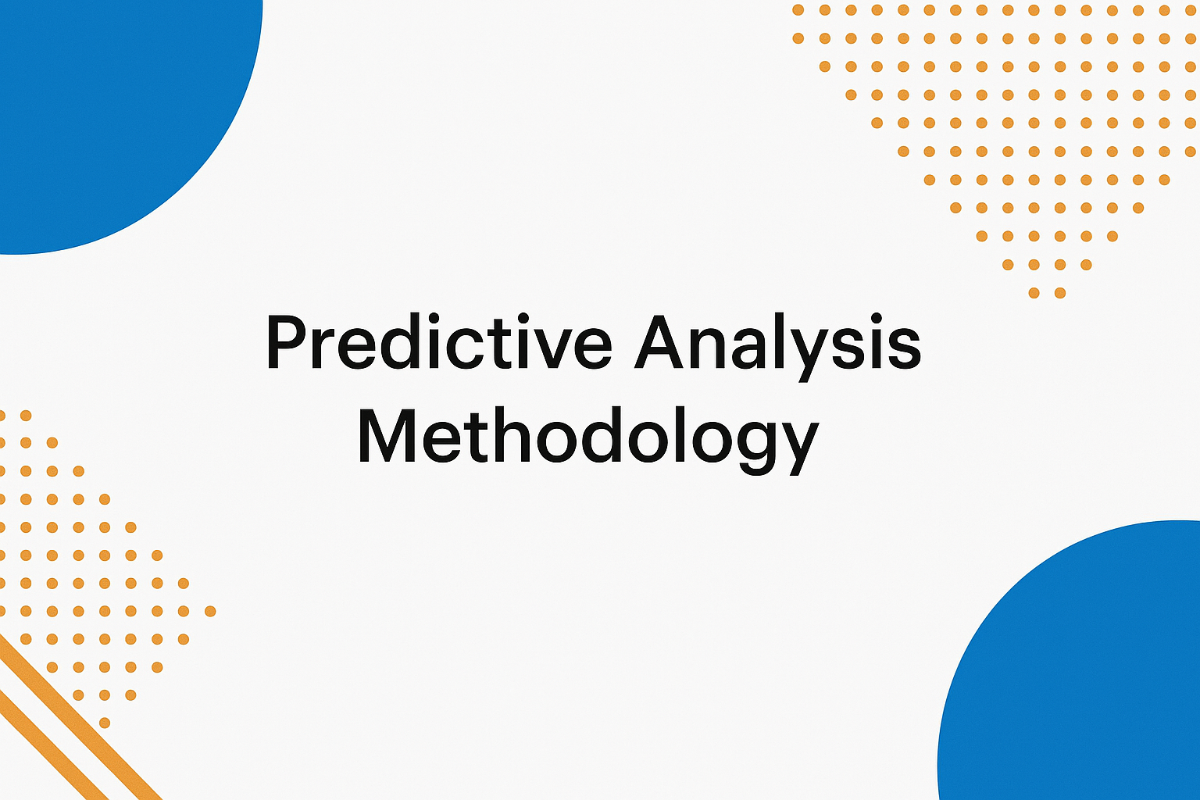

Slide 2
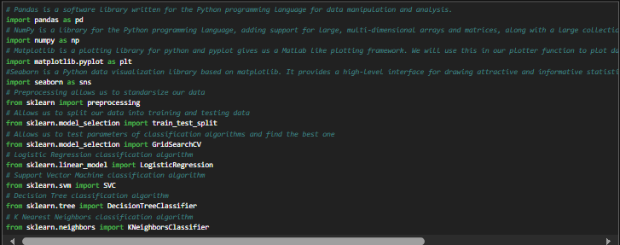
Modeling Approach
Modeling Approach
Specify the algorithms used (e.g., Logistic Regression, Random Forest, XGBoost).
Justify your choice briefly (e.g., interpretability vs. accuracy).
Training & Validation Strategy
Describe how you split the data (e.g., 80/20 train-test split, k-fold cross-validation).
Mention any hyperparameter tuning (e.g., GridSearchCV).

Slide 3
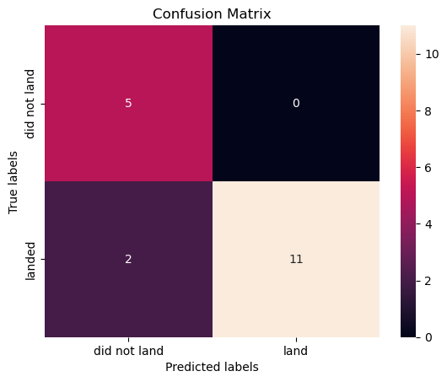
Evaluation Metrics
Accuracy: Over 90%
Confusion Matrix:
Precision (Landed): 1.00
Recall (Landed): 0.846
Precision (Did Not Land): 0.714
Recall (Did Not Land): 1.00
Insights: Strong performance with minimal false positives

